Slide 1
Backpropagation
Gabriella Miles

Slide 2
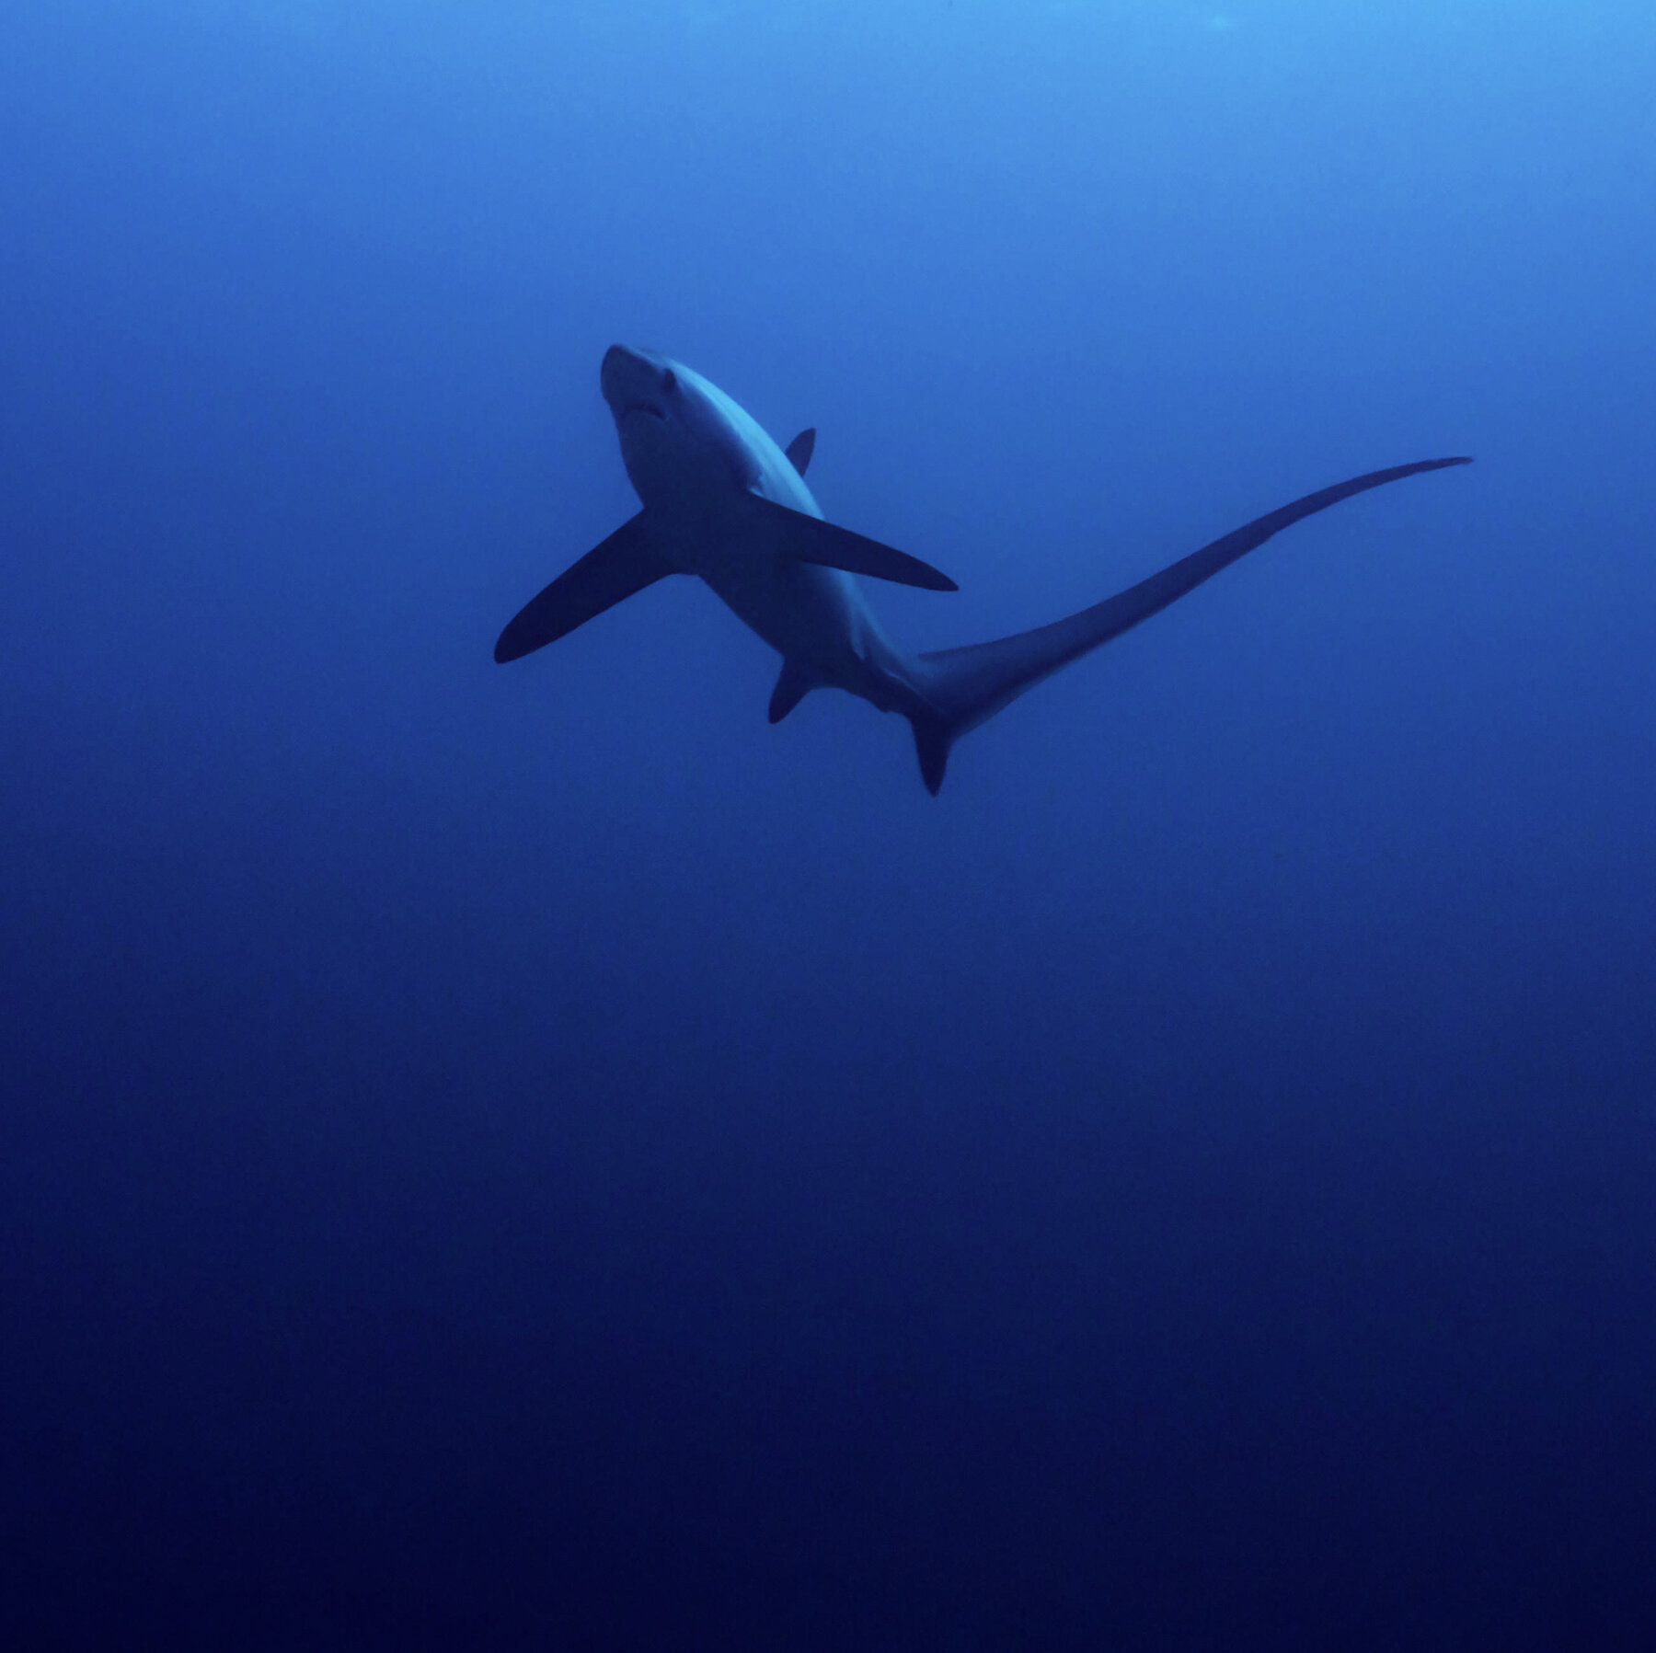
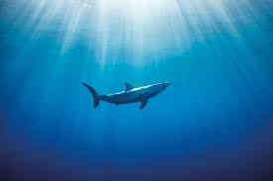

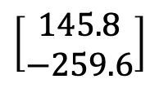
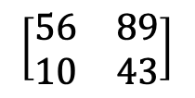
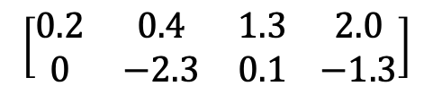
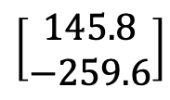
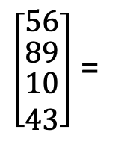

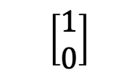
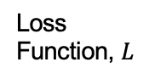
Recap
Ask questions: menti.com
Code: 7201 0048
Some kind of input
Weights (or parameters)
$$f\left(x,W\right)$$
Loss
Function, $L$
Loss
56
89
$$\left[\begin{matrix}56 & 89 \\ 10 & 43\end{matrix}\right]$$
$$Wx$$
$$\left[\begin{matrix}145.8 \\ −259.6\end{matrix}\right]$$
$$\left[\begin{matrix}1 \\ 0\end{matrix}\right]$$
10
43
$\left[\begin{matrix}56 \\ \begin{matrix}89 \\ \begin{matrix}10 \\ 43\end{matrix}\end{matrix}\end{matrix}\right]$ =
$$\left[\begin{matrix}0.2 & 0.4 & 1.3 \\ 0 & −2.3 & 0.1\end{matrix} \begin{matrix}2.0 \\ −1.3\end{matrix}\right]$$
$$\left[\begin{matrix}145.8 \\ −259.6\end{matrix}\right]$$
Review maths worksheet 1 if you are feeling rusty on your matrix operations!
Notes:
And this is following on from our earlier work…
So, recall that last week we looked at how for a given function [CLICK], we have an inputs x [CLICK] which is some kind of input to our function (maybe images [CLICK], or some other kind of data). Maybe here we’re trying to differentiate between these two species of shark, and to us this is a straightforward task, we can see some notable differences between these two images, but to the computer [CLICK] (which only sees this numerical representation) – this is quite challenging! We used this toy example of a 2x2 matrix with just a single channel, so assuming that our image is black and white, and we’ll feed this into [CLICK] our model.
We also have this W [CLICK], which are the weights (or parameters of our function).
And the simplest way of combining x and W, as we’ve done here, is probably to multiply them together – which is our classic linear classifier.
So we can carry out the calculation Wx [CLICK] where we’ve randomly initialised our W – so just some straightforward matrix multiplication to get the answer, which is our output [CLICK].
We also have our ground truth [CLICK] – the answer that we hope to get (or get very close to right?), and the difference between our prediction and the ground truth is called our loss [CLICK]. We briefly spoke about different loss functions as well – how to quantify loss in a way that’s useful to us, but I’m not going to cover that again in this class.

Slide 3



$$∇_{w}L$$
Notes:
We also discussed this idea of a loss landscape. Where every x,y point [CLICK] – or maybe in this case every longitude, latitude point represents a different W. And our altitude here is how big our loss is – the higher up we are, the more wrong we are in our output compared to our loss.
And we talked a little bit about how we can use a method called gradient descent to calculate the gradients and take small steps [CLICK] down this slope to decrease our loss. And if we repeat that [CLICK] enough times we hopefully end up at the lowest altitude, which represents our minimum loss.
So what we want to do is find the parameters W, that correspond to the lowest loss. We want to find the gradient of this loss function, with respect to W.

Slide 4
What next?
Ask questions: menti.com
Code: 7201 0048
Let’s come up with a way of efficiently finding the parameters that minimise the loss function.
Backpropagation
Notes:
So what we’re going to get into today [CLICK] is how we can go about calculating those gradients in an efficient way.
And for that we need to introduce the algorithm [CLICK]: backpropagation.
Show of hands, who’s heard of this term before? It doesn’t count if the first time you heard was on the title slide.

Slide 5
Objectives
Ask questions: menti.com
Code: 7201 0048
Understand:
What backpropagation is
How it works
Why it’s useful to us
Notes:
So by the end of this lecture you should have an intuitive understanding of what we mean when we say “backpropagation” as well as how it works mathematically – and to start to have some ideas about how to put this into practice in a practical way.
We’re going to start with some basic examples to build understanding – which could definitely be approached in a different way, but we’re going to stick with our backpropagation approach and towards the end of the lecture, we’ll discuss why doing it this way is useful.

Slide 6
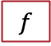
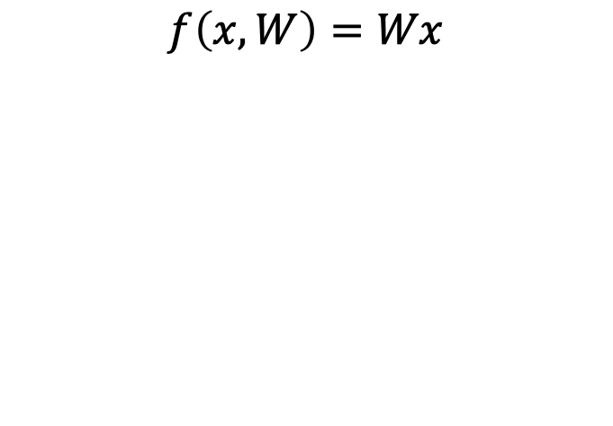





Computational Graphs
Ask questions: menti.com
Code: 7201 0048
$$f\left(x,W\right)=Wx$$
$$f\left(x,y, z\right)=x\left(y+z\right)$$
Hint: you will need 2 nodes!
$$x$$
$$f$$
$$×$$
$$W$$
Notes:
Alright, so let’s get started. And before we get into the maths, let’s do some drawing.
So [CLICK], let’s return to the function we’ve been using, our linear classifier. And what we want to do here is draw a computational graph which plots out each step of our function.
Fortunately, for me, this one is quite straightforward we only have one operation – our multiplication [CLICK], so we have one multiplication node, which has two inputs [CLICK], and the output [CLICK]. Nice.
Okay – your turn. We have this function here, which has three inputs, and we get the output by adding y and z together, before multiplying it all by x.
So, I’ll give you 2 minutes to have a go sketching this out on your whiteboards, and when you have the answer, hold up your whiteboard. Just as a hint, in our first example we had one node, but in this one you’ll need two [CLICK]. Okay – 2 minutes, go!

Slide 7
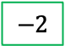
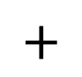
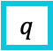

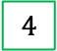
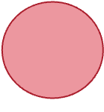


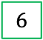

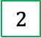


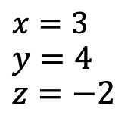
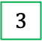

The Forward Pass
Ask questions: menti.com
Code: 7201 0048
$$x=3$$
$$y=4$$
$$z=−2$$
$$f\left(x,y, z\right)=x\left(y+z\right)$$
$$4$$
$$y$$
$$q$$
$$2$$
$$+$$
$$−2$$
$$z$$
$$6$$
$$×$$
$$f$$
$$3$$
$$x$$
Check out the Computational Graph Worksheet if you’d like some extra practice!
Notes:
Cool – some amazingly quick answers there!
Excellent – so here we have the answer [CLICK], we combine our y and z variables in this addition node, and combine the output of that with x, at this multiplication node to get our output.
And don’t worry if this was something you struggled with a bit. It takes a bit of time to think about equations in this way. If you’d like some more practice [CLICK] feel free to check out some of the worksheets on the github.
Okay, so having got our computational graph. Let’s say we’ve been given inputs for x, y, and z [CLICK]. Let’s input these to our function [CLICK]-, and do a forward pass through our computational graph.
Okay, so just to be clear, and make sure we’re all talking about the same things, we’re going to call this intermediate addition node q [CLICK]. And the output at q is 4-2 so 2 [CLICK].
We then multiply q by x to get the output of our function – 6.
Okay so any questions about the forward pass?

Slide 8

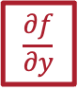


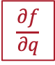
Backpropagation
Ask questions: menti.com
Code: 7201 0048
$$f\left(x,y, z\right)=x\left(y+z\right)$$
$$4$$
$$y$$
$$q$$
$$\frac{∂f}{∂y}$$
$$2$$
$$+$$
$$−2$$
$$\frac{∂f}{∂q}$$
$$z$$
$$6$$
$$\frac{∂f}{∂z}$$
$$×$$
$$f$$
$$\frac{∂f}{∂f}$$
$$3$$
$$x$$
$$\frac{∂f}{∂x}$$
Notes:
In which case, we’ll move on to backpropagation. What we want is the gradients [CLICK] of derivative of f with respect to x, y, and z. So we just need to do forward propagation in reverse.
And by that I mean we’ll start at the far end, the output end of our network and [CLICK] compute the gradient of the output with respect to the last variable, which is just f. And we’ll work back through [CLICK] computing the gradient at each intermediary node, with respect to the node.
We can see there, and our first calculation [CLICK] df/df is somewhat trivial [CLICK] – we know the answer here is going to be one.

Slide 9
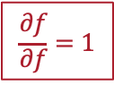
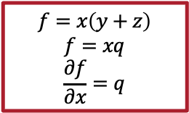
Backpropagation
Ask questions: menti.com
Code: 7201 0048
$$f\left(x,y, z\right)=x\left(y+z\right)$$
$$f=x\left(y+z\right)$$
$$f=xq$$
$$\frac{∂f}{∂x}=q$$
$$4$$
$$y$$
$$q$$
$$\frac{∂f}{∂y}$$
$$2$$
$$+$$
$$−2$$
$$\frac{∂f}{∂q}$$
$$z$$
$$6$$
$$\frac{∂f}{∂z}$$
$$×$$
$$f$$
$$\frac{∂f}{∂f}=1$$
$$3$$
$$x$$
$$\frac{∂f}{∂x}$$
Notes:
Let’s start with df over dx first [CLICK], and think about how we can compute this.
So we have our equation [CLICK] for the function – we have f is equal to x multiplied by y plus z. We can simplify this expression slightly [CLICK] by substituting in q for y+z. Hopefully you remember your A-level maths, and how to differentiate – so if we calculate [CLICK] df/dx we get q.
Okay cool – so if df/dx is equal to q, then that means the value of our gradient down here is equal to 2 [CLICK].

Slide 10
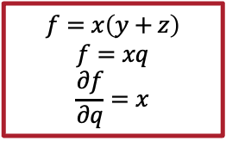
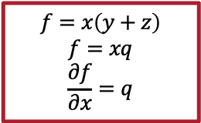
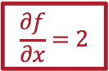
Backpropagation
Ask questions: menti.com
Code: 7201 0048
$$f\left(x,y, z\right)=x\left(y+z\right)$$
$$f=x\left(y+z\right)$$
$$f=xq$$
$$\frac{∂f}{∂x}=q$$
$$f=x\left(y+z\right)$$
$$f=xq$$
$$\frac{∂f}{∂q}=x$$
$$4$$
$$y$$
$$q$$
$$\frac{∂f}{∂y}$$
$$2$$
$$+$$
$$−2$$
$$\frac{∂f}{∂q}$$
$$z$$
$$6$$
$$\frac{∂f}{∂z}$$
$$×$$
$$f$$
$$\frac{∂f}{∂f}=1$$
$$3$$
$$x$$
$$\frac{∂f}{∂x}=2$$
Notes:
What about if we take this original f = xq expression and differentiate it to get df/dq, what answer would we get?
Yeah, excellent [CLICK], we would get df/dq is equal to x. So that means the gradient at this node is going to equal [CLICK] 3. Perfect – any questions so far? [CLICK]

Slide 11

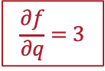
Backpropagation
Ask questions: menti.com
Code: 7201 0048
$$f\left(x,y, z\right)=x\left(y+z\right)$$
$$f=x\left(y+z\right)$$
$$f=xq$$
$$\frac{∂f}{∂x}=q$$
$$f=x\left(y+z\right)$$
$$f=xq$$
$$\frac{∂f}{∂q}=x$$
$$4$$
$$y$$
$$q$$
$$\frac{∂f}{∂y}$$
$$2$$
$$+$$
$$−2$$
$$\frac{∂f}{∂q}=3$$
$$z$$
$$6$$
$$\frac{∂f}{∂z}$$
$$×$$
$$f$$
$$\frac{∂f}{∂f}=1$$
$$3$$
$$x$$
$$\frac{∂f}{∂x}=2$$

Slide 12
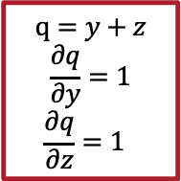
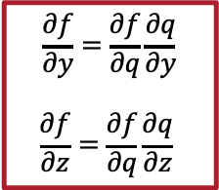
Backpropagation
Ask questions: menti.com
Code: 7201 0048
$$f\left(x,y, z\right)=x\left(y+z\right)$$
$$\frac{∂f}{∂y}=\frac{∂f}{∂q}\frac{∂q}{∂y}$$
$$\frac{∂f}{∂z}=\frac{∂f}{∂q}\frac{∂q}{∂z}$$
$$q=y+z$$
$$\frac{∂q}{∂y}=1$$
$$\frac{∂q}{∂z}=1$$
$$4$$
$$y$$
$$q$$
$$\frac{∂f}{∂y}$$
$$2$$
$$+$$
$$−2$$
$$\frac{∂f}{∂q}=3$$
$$z$$
$$6$$
$$\frac{∂f}{∂z}$$
$$×$$
$$f$$
$$\frac{∂f}{∂f}=1$$
$$3$$
$$x$$
$$\frac{∂f}{∂x}=2$$
Review maths worksheet 2 if you are feeling rusty on the chain rule!
Notes:
We now want to look at calculating the gradients df/dy [CLICK] and df/dz, but we can’t do that immediately, because we have this intermediary node right.
Thankfully we have a hero that can help us out! Enter the chain rule! [CLICK]
Using the chain rule we can calculate df/dy by multiplying df/dq by dq/dy. So I’ll give you 1 minute – what expression would we use to calculate df/dz – write it down on your whiteboard, and then hold it up when you have the answer.
[CLICK]
Excellent, really similar to our expression for df/dy.
So we already know how we can express q [CLICK], y plus z.
If we differentiate this to get dq/dy we’ll get… [CLICK] 1.
And the same if we do dq/dz [CLICK].
[CLICK] Okay – so it won’t get much more complicated that this during this lecture, but I’d recommend checking out the maths workbook if any of this feels like an alien language.
So we know that df/dy is expressed by df/dq multipled by dq/dy. We can simplifgy dq/dy to 1, which just leaves us with df/dq which is 3 [CLICK].

Slide 13
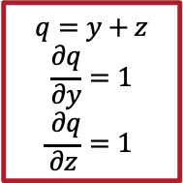
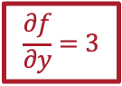
Backpropagation
Ask questions: menti.com
Code: 7201 0048
$$f\left(x,y, z\right)=x\left(y+z\right)$$
$$\frac{∂f}{∂y}=\frac{∂f}{∂q}\frac{∂q}{∂y}$$
$$\frac{∂f}{∂z}=\frac{∂f}{∂q}\frac{∂q}{∂z}$$
$$q=y+z$$
$$\frac{∂q}{∂y}=1$$
$$\frac{ ∂q}{∂z}=1$$
$$4$$
$$y$$
$$q$$
$$\frac{∂f}{∂y}=3$$
$$2$$
$$+$$
$$−2$$
$$\frac{∂f}{∂q}=3$$
$$z$$
$$6$$
$$\frac{∂f}{∂z}$$
$$×$$
$$f$$
$$\frac{∂f}{∂f}=1$$
$$3$$
$$x$$
$$\frac{∂f}{∂x}=2$$
Review maths worksheet 2 if you are feeling rusty on the chain rule!
Notes:
Looking at df/dz [CLICK], we can see that it’s actually the same.

Slide 14
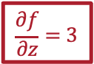
Backpropagation
Ask questions: menti.com
Code: 7201 0048
$$f\left(x,y, z\right)=x\left(y+z\right)$$
$$\frac{∂f}{∂y}=\frac{∂f}{∂q}\frac{∂q}{∂y}$$
$$\frac{∂f}{∂z}=\frac{∂f}{∂q}\frac{∂q}{∂z}$$
$$q=y+z$$
$$\frac{∂q}{∂y}=1$$
$$\frac{∂q}{∂z}=1$$
$$4$$
$$y$$
$$q$$
$$\frac{∂f}{∂y}=3$$
$$2$$
$$+$$
$$−2$$
$$\frac{∂f}{∂q}=3$$
$$z$$
$$6$$
$$\frac{∂f}{∂z}=3$$
$$×$$
$$f$$
$$\frac{∂f}{∂f}=1$$
$$3$$
$$x$$
$$\frac{∂f}{∂x}=2$$
Review maths worksheet 2 if you are feeling rusty on the chain rule!

Slide 15
Your turn!
Ask questions: menti.com
Code: 7201 0048
Present your problem and answer to the class.
Problem Number | Groups
2 | 1, 4, 7, 10, 13
3 | 2, 5, 8, 11, 14
4 | 3, 6, 9, 12, 15
Notes:
So we’ll do some practice of this in your groups. Each group was assigned a number, and this corresponds to a specific practice problem. I’d like you to draw out the computational graph, calculate the forward pass, and then do the backward pass of your network. I’ll give you 10 minutes, and then we’ll call on a group to come up and present their problem and answer to the class.

Slide 16

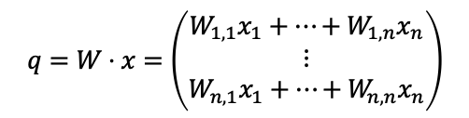
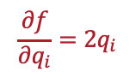

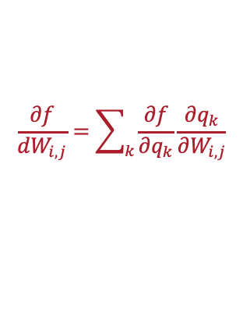


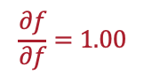
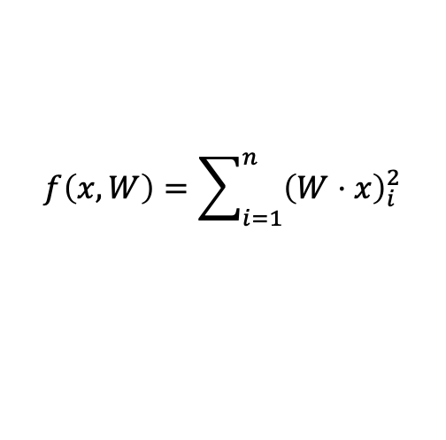
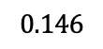
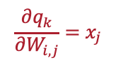

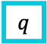
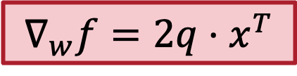

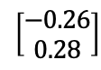
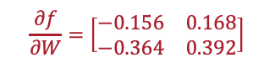
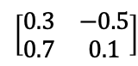
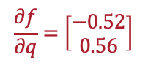
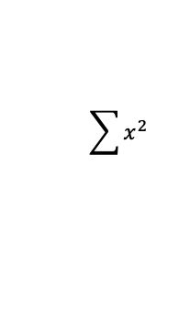
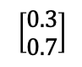
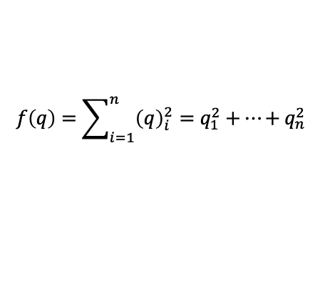
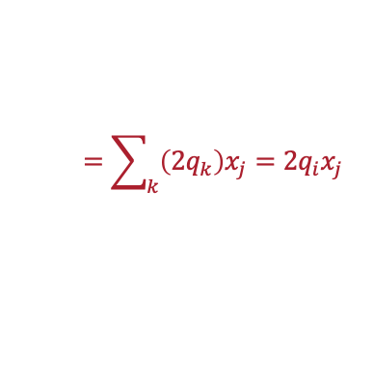
Vectorised…
Ask questions: menti.com
Code: 7201 0048
$$f\left(x,W\right)=\sum_{i=1}^{n}{{\left(W⋅x\right)}_{i}^{2}}$$
$$∇_{w}f=2q⋅x^{T}$$
$$\left[\begin{matrix}0.3 \\ 0.7\end{matrix}\right]$$
$$x$$
$$q$$
$$f$$
$$\left[\begin{matrix}−0.26 \\ 0.28\end{matrix}\right]$$
$$0.146$$
$$×$$
$$\sum{x^{2}}$$
$$\left[\begin{matrix}0.3 & −0.5 \\ 0.7 & 0.1\end{matrix}\right]$$
$$\frac{∂f}{∂q}=\left[\begin{matrix}−0.52 \\ 0.56\end{matrix}\right]$$
$$\frac{∂f}{∂f}=1.00$$
$$W$$
$$\frac{∂f}{∂W}=\left[\begin{matrix}−0.156 & 0.168 \\ −0.364 & 0.392\end{matrix}\right]$$
$$q=W⋅x=\left(\begin{matrix}W_{1,1}x_{1}+…+W_{1, n}x_{n} \\ ⋮ \\ W_{n,1}x_{1}+…+W_{n,n}x_{n}\end{matrix}\right)$$
$$\frac{∂q_{k}}{∂W_{i,j}}=x_{j}$$
$$f\left(q\right)=\sum_{i=1}^{n}{{\left(q\right)}_{i}^{2}}=q_{1}^{2}+…+q_{n}^{2}$$
$$\frac{∂f}{∂q_{i}}=2q_{i}$$
$$\frac{∂f}{dW_{i, j}}=\sum_{k}{\frac{∂f}{∂q_{k}}\frac{∂q_{k}}{∂W_{i, j}}}$$
$$=\sum_{k}{\left(2q_{k}\right)x_{j}=2q_{i}x_{j} }$$
Notes:
Okay so this is all well and good working with single inputs, but using neural networks, a lot of our inputs are going to be matrices. So how do we expand this to a vectorised form.
Okay, let’s take our model [CLICK] and here we’ve got our same two inputs W and x, and we’re applying two operations – we’re multiplying W and x together, and then calculating the L2 norm.
....
To calculate the gradient at our intermediary node q, we can do that element-wise [CLICK] with this expression here. Great. Using this we can calculate the values of our gradients [CLICK].
Now do look at this expression for q. Let’s just consider the first element, so to compute dq over dW we need to differentiate Wx with respect to W – what would we get? X, perfect [CLICK].
Okay so let’s use the chain rule again [CLICK] to compute the df over dW. We can simplify this down [CLICK] like so, which is much more manageable. And we can go ahead and calculate that [CLICK].
If we wanted to write this in vector form – we could use this expression [CLICK] here. So the gradient of W with respect to f is equal to 2q (the derivative at q) multiplied by x (and we transpose it so that we can multiply these two matrices together).

Slide 17
Vectorised…
Ask questions: menti.com
Code: 7201 0048
$$f\left(x,W\right)=\sum_{i=1}^{n}{{\left(W⋅x\right)}_{i}^{2}}$$
$$\left[\begin{matrix}0.3 \\ 0.7\end{matrix}\right]$$
$$x$$
$$q$$
$$f$$
$$\left[\begin{matrix}−0.26 \\ 0.28\end{matrix}\right]$$
$$0.146$$
$$×$$
$$\sum{x^{2}}$$
$$\left[\begin{matrix}0.3 & −0.5 \\ 0.7 & 0.1\end{matrix}\right]$$
$$W$$
$$q=W⋅x=\left(\begin{matrix}W_{1,1}x_{1}+…+W_{1, n}x_{n} \\ ⋮ \\ W_{n,1}x_{1}+…+W_{n,n}x_{n}\end{matrix}\right)$$
$$f\left(q\right)=\sum_{i=1}^{n}{{\left(q\right)}_{i}^{2}}=q_{1}^{2}+…+q_{n}^{2}$$
Notes:
Okay so this is all well and good working with single inputs, but using neural networks, a lot of our inputs are going to be matrices. So how do we expand this to a vectorised form.
Okay, let’s take our model [CLICK] and here we’ve got our same two inputs W and x, and we’re applying two operations – we’re multiplying W and x together, and then calculating the L2 norm.
....
To calculate the gradient at our intermediary node q, we can do that element-wise [CLICK] with this expression here. Great. Using this we can calculate the values of our gradients [CLICK].
Now do look at this expression for q. Let’s just consider the first element, so to compute dq over dW we need to differentiate Wx with respect to W – what would we get? X, perfect [CLICK].
Okay so let’s use the chain rule again [CLICK] to compute the df over dW. We can simplify this down [CLICK] like so, which is much more manageable. And we can go ahead and calculate that [CLICK].
If we wanted to write this in vector form – we could use this expression [CLICK] here. So the gradient of W with respect to f is equal to 2q (the derivative at q) multiplied by x (and we transpose it so that we can multiply these two matrices together).

Slide 18
Vectorised…
Ask questions: menti.com
Code: 7201 0048
$$f\left(x,W\right)=\sum_{i=1}^{n}{{\left(W⋅x\right)}_{i}^{2}}$$
$$\left[\begin{matrix}0.3 \\ 0.7\end{matrix}\right]$$
$$x$$
$$q$$
$$f$$
$$\left[\begin{matrix}−0.26 \\ 0.28\end{matrix}\right]$$
$$0.146$$
$$×$$
$$\sum{x^{2}}$$
$$\left[\begin{matrix}0.3 & −0.5 \\ 0.7 & 0.1\end{matrix}\right]$$
$$\frac{∂f}{∂f}=1.00$$
$$W$$
$$q=W⋅x=\left(\begin{matrix}W_{1,1}x_{1}+…+W_{1, n}x_{n} \\ ⋮ \\ W_{n,1}x_{1}+…+W_{n,n}x_{n}\end{matrix}\right)$$
$$f\left(q\right)=\sum_{i=1}^{n}{{\left(q\right)}_{i}^{2}}=q_{1}^{2}+…+q_{n}^{2}$$
Notes:
Okay so this is all well and good working with single inputs, but using neural networks, a lot of our inputs are going to be matrices. So how do we expand this to a vectorised form.
Okay, let’s take our model [CLICK] and here we’ve got our same two inputs W and x, and we’re applying two operations – we’re multiplying W and x together, and then calculating the L2 norm.
....
To calculate the gradient at our intermediary node q, we can do that element-wise [CLICK] with this expression here. Great. Using this we can calculate the values of our gradients [CLICK].
Now do look at this expression for q. Let’s just consider the first element, so to compute dq over dW we need to differentiate Wx with respect to W – what would we get? X, perfect [CLICK].
Okay so let’s use the chain rule again [CLICK] to compute the df over dW. We can simplify this down [CLICK] like so, which is much more manageable. And we can go ahead and calculate that [CLICK].
If we wanted to write this in vector form – we could use this expression [CLICK] here. So the gradient of W with respect to f is equal to 2q (the derivative at q) multiplied by x (and we transpose it so that we can multiply these two matrices together).

Slide 19
Vectorised…
Ask questions: menti.com
Code: 7201 0048
$$f\left(x,W\right)=\sum_{i=1}^{n}{{\left(W⋅x\right)}_{i}^{2}}$$
$$\left[\begin{matrix}0.3 \\ 0.7\end{matrix}\right]$$
$$x$$
$$q$$
$$f$$
$$\left[\begin{matrix}−0.26 \\ 0.28\end{matrix}\right]$$
$$0.146$$
$$×$$
$$\sum{x^{2}}$$
$$\left[\begin{matrix}0.3 & −0.5 \\ 0.7 & 0.1\end{matrix}\right]$$
$$\frac{∂f}{∂f}=1.00$$
$$W$$
$$q=W⋅x=\left(\begin{matrix}W_{1,1}x_{1}+…+W_{1, n}x_{n} \\ ⋮ \\ W_{n,1}x_{1}+…+W_{n,n}x_{n}\end{matrix}\right)$$
$$f\left(q\right)=\sum_{i=1}^{n}{{\left(q\right)}_{i}^{2}}=q_{1}^{2}+…+q_{n}^{2}$$
$$\frac{∂f}{∂q_{i}}=2q_{i}$$
Notes:
Okay so this is all well and good working with single inputs, but using neural networks, a lot of our inputs are going to be matrices. So how do we expand this to a vectorised form.
Okay, let’s take our model [CLICK] and here we’ve got our same two inputs W and x, and we’re applying two operations – we’re multiplying W and x together, and then calculating the L2 norm.
....
To calculate the gradient at our intermediary node q, we can do that element-wise [CLICK] with this expression here. Great. Using this we can calculate the values of our gradients [CLICK].
Now do look at this expression for q. Let’s just consider the first element, so to compute dq over dW we need to differentiate Wx with respect to W – what would we get? X, perfect [CLICK].
Okay so let’s use the chain rule again [CLICK] to compute the df over dW. We can simplify this down [CLICK] like so, which is much more manageable. And we can go ahead and calculate that [CLICK].
If we wanted to write this in vector form – we could use this expression [CLICK] here. So the gradient of W with respect to f is equal to 2q (the derivative at q) multiplied by x (and we transpose it so that we can multiply these two matrices together).

Slide 20
Vectorised…
Ask questions: menti.com
Code: 7201 0048
$$f\left(x,W\right)=\sum_{i=1}^{n}{{\left(W⋅x\right)}_{i}^{2}}$$
$$\left[\begin{matrix}0.3 \\ 0.7\end{matrix}\right]$$
$$x$$
$$q$$
$$f$$
$$\left[\begin{matrix}−0.26 \\ 0.28\end{matrix}\right]$$
$$0.146$$
$$×$$
$$\sum{x^{2}}$$
$$\left[\begin{matrix}0.3 & −0.5 \\ 0.7 & 0.1\end{matrix}\right]$$
$$\frac{∂f}{∂q}=\left[\begin{matrix}−0.52 \\ 0.56\end{matrix}\right]$$
$$\frac{∂f}{∂f}=1.00$$
$$W$$
$$q=W⋅x=\left(\begin{matrix}W_{1,1}x_{1}+…+W_{1, n}x_{n} \\ ⋮ \\ W_{n,1}x_{1}+…+W_{n,n}x_{n}\end{matrix}\right)$$
$$f\left(q\right)=\sum_{i=1}^{n}{{\left(q\right)}_{i}^{2}}=q_{1}^{2}+…+q_{n}^{2}$$
$$\frac{∂f}{∂q_{i}}=2q_{i}$$
Notes:
Okay so this is all well and good working with single inputs, but using neural networks, a lot of our inputs are going to be matrices. So how do we expand this to a vectorised form.
Okay, let’s take our model [CLICK] and here we’ve got our same two inputs W and x, and we’re applying two operations – we’re multiplying W and x together, and then calculating the L2 norm.
....
To calculate the gradient at our intermediary node q, we can do that element-wise [CLICK] with this expression here. Great. Using this we can calculate the values of our gradients [CLICK].
Now do look at this expression for q. Let’s just consider the first element, so to compute dq over dW we need to differentiate Wx with respect to W – what would we get? X, perfect [CLICK].
Okay so let’s use the chain rule again [CLICK] to compute the df over dW. We can simplify this down [CLICK] like so, which is much more manageable. And we can go ahead and calculate that [CLICK].
If we wanted to write this in vector form – we could use this expression [CLICK] here. So the gradient of W with respect to f is equal to 2q (the derivative at q) multiplied by x (and we transpose it so that we can multiply these two matrices together).

Slide 21
Vectorised…
Ask questions: menti.com
Code: 7201 0048
$$f\left(x,W\right)=\sum_{i=1}^{n}{{\left(W⋅x\right)}_{i}^{2}}$$
$$\left[\begin{matrix}0.3 \\ 0.7\end{matrix}\right]$$
$$x$$
$$q$$
$$f$$
$$\left[\begin{matrix}−0.26 \\ 0.28\end{matrix}\right]$$
$$0.146$$
$$×$$
$$\sum{x^{2}}$$
$$\left[\begin{matrix}0.3 & −0.5 \\ 0.7 & 0.1\end{matrix}\right]$$
$$\frac{∂f}{∂q}=\left[\begin{matrix}−0.52 \\ 0.56\end{matrix}\right]$$
$$\frac{∂f}{∂f}=1.00$$
$$W$$
$$q=W⋅x=\left(\begin{matrix}W_{1,1}x_{1}+…+W_{1, n}x_{n} \\ ⋮ \\ W_{n,1}x_{1}+…+W_{n,n}x_{n}\end{matrix}\right)$$
$$\frac{∂q_{k}}{∂W_{i,j}}=x_{j}$$
$$f\left(q\right)=\sum_{i=1}^{n}{{\left(q\right)}_{i}^{2}}=q_{1}^{2}+…+q_{n}^{2}$$
$$\frac{∂f}{∂q_{i}}=2q_{i}$$
Notes:
Okay so this is all well and good working with single inputs, but using neural networks, a lot of our inputs are going to be matrices. So how do we expand this to a vectorised form.
Okay, let’s take our model [CLICK] and here we’ve got our same two inputs W and x, and we’re applying two operations – we’re multiplying W and x together, and then calculating the L2 norm.
....
To calculate the gradient at our intermediary node q, we can do that element-wise [CLICK] with this expression here. Great. Using this we can calculate the values of our gradients [CLICK].
Now do look at this expression for q. Let’s just consider the first element, so to compute dq over dW we need to differentiate Wx with respect to W – what would we get? X, perfect [CLICK].
Okay so let’s use the chain rule again [CLICK] to compute the df over dW. We can simplify this down [CLICK] like so, which is much more manageable. And we can go ahead and calculate that [CLICK].
If we wanted to write this in vector form – we could use this expression [CLICK] here. So the gradient of W with respect to f is equal to 2q (the derivative at q) multiplied by x (and we transpose it so that we can multiply these two matrices together).

Slide 22
Vectorised…
Ask questions: menti.com
Code: 7201 0048
$$f\left(x,W\right)=\sum_{i=1}^{n}{{\left(W⋅x\right)}_{i}^{2}}$$
$$\left[\begin{matrix}0.3 \\ 0.7\end{matrix}\right]$$
$$x$$
$$q$$
$$f$$
$$\left[\begin{matrix}−0.26 \\ 0.28\end{matrix}\right]$$
$$0.146$$
$$×$$
$$\sum{x^{2}}$$
$$\left[\begin{matrix}0.3 & −0.5 \\ 0.7 & 0.1\end{matrix}\right]$$
$$\frac{∂f}{∂q}=\left[\begin{matrix}−0.52 \\ 0.56\end{matrix}\right]$$
$$\frac{∂f}{∂f}=1.00$$
$$W$$
$$q=W⋅x=\left(\begin{matrix}W_{1,1}x_{1}+…+W_{1, n}x_{n} \\ ⋮ \\ W_{n,1}x_{1}+…+W_{n,n}x_{n}\end{matrix}\right)$$
$$\frac{∂q_{k}}{∂W_{i,j}}=x_{j}$$
$$f\left(q\right)=\sum_{i=1}^{n}{{\left(q\right)}_{i}^{2}}=q_{1}^{2}+…+q_{n}^{2}$$
$$\frac{∂f}{∂q_{i}}=2q_{i}$$
$$\frac{∂f}{dW_{i, j}}=\sum_{k}{\frac{∂f}{∂q_{k}}\frac{∂q_{k}}{∂W_{i, j}}}$$
$$=\sum_{k}{\left(2q_{k}\right)x_{j}=2q_{i}x_{j} }$$
Notes:
Okay so this is all well and good working with single inputs, but using neural networks, a lot of our inputs are going to be matrices. So how do we expand this to a vectorised form.
Okay, let’s take our model [CLICK] and here we’ve got our same two inputs W and x, and we’re applying two operations – we’re multiplying W and x together, and then calculating the L2 norm.
....
To calculate the gradient at our intermediary node q, we can do that element-wise [CLICK] with this expression here. Great. Using this we can calculate the values of our gradients [CLICK].
Now do look at this expression for q. Let’s just consider the first element, so to compute dq over dW we need to differentiate Wx with respect to W – what would we get? X, perfect [CLICK].
Okay so let’s use the chain rule again [CLICK] to compute the df over dW. We can simplify this down [CLICK] like so, which is much more manageable. And we can go ahead and calculate that [CLICK].
If we wanted to write this in vector form – we could use this expression [CLICK] here. So the gradient of W with respect to f is equal to 2q (the derivative at q) multiplied by x (and we transpose it so that we can multiply these two matrices together).

Slide 23
Vectorised…
Ask questions: menti.com
Code: 7201 0048
$$f\left(x,W\right)=\sum_{i=1}^{n}{{\left(W⋅x\right)}_{i}^{2}}$$
$$\left[\begin{matrix}0.3 \\ 0.7\end{matrix}\right]$$
$$x$$
$$q$$
$$f$$
$$\left[\begin{matrix}−0.26 \\ 0.28\end{matrix}\right]$$
$$0.146$$
$$×$$
$$\sum{x^{2}}$$
$$\left[\begin{matrix}0.3 & −0.5 \\ 0.7 & 0.1\end{matrix}\right]$$
$$\frac{∂f}{∂q}=\left[\begin{matrix}−0.52 \\ 0.56\end{matrix}\right]$$
$$\frac{∂f}{∂f}=1.00$$
$$W$$
$$\frac{∂f}{∂W}=\left[\begin{matrix}−0.156 & 0.168 \\ −0.364 & 0.392\end{matrix}\right]$$
$$q=W⋅x=\left(\begin{matrix}W_{1,1}x_{1}+…+W_{1, n}x_{n} \\ ⋮ \\ W_{n,1}x_{1}+…+W_{n,n}x_{n}\end{matrix}\right)$$
$$\frac{∂q_{k}}{∂W_{i,j}}=x_{j}$$
$$f\left(q\right)=\sum_{i=1}^{n}{{\left(q\right)}_{i}^{2}}=q_{1}^{2}+…+q_{n}^{2}$$
$$\frac{∂f}{∂q_{i}}=2q_{i}$$
$$\frac{∂f}{dW_{i, j}}=\sum_{k}{\frac{∂f}{∂q_{k}}\frac{∂q_{k}}{∂W_{i, j}}}$$
$$=\sum_{k}{\left(2q_{k}\right)x_{j}=2q_{i}x_{j} }$$
Notes:
Okay so this is all well and good working with single inputs, but using neural networks, a lot of our inputs are going to be matrices. So how do we expand this to a vectorised form.
Okay, let’s take our model [CLICK] and here we’ve got our same two inputs W and x, and we’re applying two operations – we’re multiplying W and x together, and then calculating the L2 norm.
....
To calculate the gradient at our intermediary node q, we can do that element-wise [CLICK] with this expression here. Great. Using this we can calculate the values of our gradients [CLICK].
Now do look at this expression for q. Let’s just consider the first element, so to compute dq over dW we need to differentiate Wx with respect to W – what would we get? X, perfect [CLICK].
Okay so let’s use the chain rule again [CLICK] to compute the df over dW. We can simplify this down [CLICK] like so, which is much more manageable. And we can go ahead and calculate that [CLICK].
If we wanted to write this in vector form – we could use this expression [CLICK] here. So the gradient of W with respect to f is equal to 2q (the derivative at q) multiplied by x (and we transpose it so that we can multiply these two matrices together).

Slide 24
Vectorised…
Ask questions: menti.com
Code: 7201 0048
$$f\left(x,W\right)=\sum_{i=1}^{n}{{\left(W⋅x\right)}_{i}^{2}}$$
$$∇_{w}f=2q⋅x^{T}$$
$$\left[\begin{matrix}0.3 \\ 0.7\end{matrix}\right]$$
$$x$$
$$q$$
$$f$$
$$\left[\begin{matrix}−0.26 \\ 0.28\end{matrix}\right]$$
$$0.146$$
$$×$$
$$\sum{x^{2}}$$
$$\left[\begin{matrix}0.3 & −0.5 \\ 0.7 & 0.1\end{matrix}\right]$$
$$\frac{∂f}{∂q}=\left[\begin{matrix}−0.52 \\ 0.56\end{matrix}\right]$$
$$\frac{∂f}{∂f}=1.00$$
$$W$$
$$q=W⋅x=\left(\begin{matrix}W_{1,1}x_{1}+…+W_{1, n}x_{n} \\ ⋮ \\ W_{n,1}x_{1}+…+W_{n,n}x_{n}\end{matrix}\right)$$
$$\frac{∂q_{k}}{∂W_{i,j}}=x_{j}$$
$$f\left(q\right)=\sum_{i=1}^{n}{{\left(q\right)}_{i}^{2}}=q_{1}^{2}+…+q_{n}^{2}$$
$$\frac{∂f}{∂q_{i}}=2q_{i}$$
$$\frac{∂f}{dW_{i, j}}=\sum_{k}{\frac{∂f}{∂q_{k}}\frac{∂q_{k}}{∂W_{i, j}}}$$
$$=\sum_{k}{\left(2q_{k}\right)x_{j}=2q_{i}x_{j} }$$
Notes:
Okay so this is all well and good working with single inputs, but using neural networks, a lot of our inputs are going to be matrices. So how do we expand this to a vectorised form.
Okay, let’s take our model [CLICK] and here we’ve got our same two inputs W and x, and we’re applying two operations – we’re multiplying W and x together, and then calculating the L2 norm.
....
To calculate the gradient at our intermediary node q, we can do that element-wise [CLICK] with this expression here. Great. Using this we can calculate the values of our gradients [CLICK].
Now do look at this expression for q. Let’s just consider the first element, so to compute dq over dW we need to differentiate Wx with respect to W – what would we get? X, perfect [CLICK].
Okay so let’s use the chain rule again [CLICK] to compute the df over dW. We can simplify this down [CLICK] like so, which is much more manageable. And we can go ahead and calculate that [CLICK].
If we wanted to write this in vector form – we could use this expression [CLICK] here. So the gradient of W with respect to f is equal to 2q (the derivative at q) multiplied by x (and we transpose it so that we can multiply these two matrices together).

Slide 25







Vectorised…
Ask questions: menti.com
Code: 7201 0048
$$f\left(x,W\right)=\sum_{i=1}^{n}{{\left(W⋅x\right)}_{i}^{2}}$$
$$∇_{x}f=W^{T}⋅2q$$
$$\left[\begin{matrix}0.3 \\ 0.7\end{matrix}\right]$$
$$\frac{∂f}{∂x}=\left[\begin{matrix}0.236 \\ 0.316\end{matrix}\right]$$
$$x$$
$$q$$
$$f$$
$$\left[\begin{matrix}−0.26 \\ 0.28\end{matrix}\right]$$
$$0.146$$
$$×$$
$$\sum{x^{2}}$$
$$\left[\begin{matrix}0.3 & −0.5 \\ 0.7 & 0.1\end{matrix}\right]$$
$$\frac{∂f}{∂q}=\left[\begin{matrix}−0.52 \\ 0.56\end{matrix}\right]$$
$$\frac{∂f}{∂f}=1.00$$
$$W$$
$$\frac{∂f}{∂W}=\left[\begin{matrix}−0.156 & 0.168 \\ −0.364 & 0.392\end{matrix}\right]$$
$$q=W⋅x=\left(\begin{matrix}W_{1,1}x_{1}+…+W_{1, n}x_{n} \\ ⋮ \\ W_{n,1}x_{1}+…+W_{n,n}x_{n}\end{matrix}\right)$$
$$\frac{∂q_{k}}{∂x_{i}}=W_{k, i}$$
$$f\left(q\right)=\sum_{i=1}^{n}{{\left(q\right)}_{i}^{2}}=q_{1}^{2}+…+q_{n}^{2}$$
$$\frac{∂f}{∂q_{i}}=2q_{i}$$
$$\frac{∂f}{dx_{i}}=\sum_{k}{\frac{∂f}{∂q_{k}}\frac{∂q_{k}}{∂x_{i}}}$$
$$=\sum_{k}{\left(2q_{k}\right)W_{k,i} }$$
Notes:
Now let’s do the same for df/dx:
We’ll differentiate this [CLICK] with respect to f this time, and get this expression here. Once again, we can use the chain rule to get df/dx[CLICK], and simplify [CLICK] this down to something easier to work with, and calculate our output [CLICK].
We can also express this in a vectorised way [CLICK]. So here we have the derivative of f with respect to x is the weight matrix, transposed, multiplied by 2q.
Any questions?

Slide 26

Coding
$$f\left(x,y, z\right)=x\left(y+z\right)$$
$$y$$
$$q$$
$$+$$
$$z$$
$$×$$
$$f$$
$$x$$
Notes:
So how do we put this into practice? This is the kind of stuff you’ll be having a go at in the tutorial this week.
For a given computational graph, we know that we need to do a forward pass through all the nodes right, and then once we have the output, a backward pass through all the nodes.
So in pseudo code, this might look something like this [CLICK]. For every node – or just to be confusing, I’ve called it gate here, I’ll update that on the released slides – do this forward calculation.
And then we have something similar for backwards.

Slide 27

Coding
$$f\left(x,W\right)=Wx$$
$$x$$
$$f$$
$$×$$
$$W$$
Notes:
[CLICK] At a node (or gate) level, our graph looks like this, we have these two inputs, and a single output.
And so our code would be something like this [CLICK]:
We have our forward operation – this is quite straightforward, we just multiply W and x together.
And then we have our backwards operation which takes in the gradient upstream, and we can caluated df/dx and df/dW. We’ll look a little more at putting this into practice in the lab sessions this week.

Slide 28









Application
Optimisation
$$w_{x}^{∗}=w_{x}−α\left(\frac{∂L}{∂w_{x}}\right)$$
$$∇_{w}L$$
56
89
$$\left[\begin{matrix}0.2 & 1.2 \\ 0.4 & 0.8\end{matrix}\right]$$
10
43
$$\left[\begin{matrix}0.3 & 0.9 \\ −0.1 & 0.7\end{matrix}\right]$$
Loss
Function, $L$
Loss
$$\left[\begin{matrix}0.27 & 0.91 \\ −0.12 & 0.73\end{matrix}\right]$$
$$Wx$$
$$\left[\begin{matrix}145.8 \\ −259.6\end{matrix}\right]$$
$$\left[\begin{matrix}1 \\ 0\end{matrix}\right]$$
Notes:
Just like to return to our loss landscape... what we've done here today is calculate the gradients right.
Given the gradient, we can take a step in the direction of our gradient in order to update our parameters.

Slide 29

Backpropagation: where did it come from?
Rumelhart, D. E., Hinton, G. E., & Williams, R. J. (1986). Learning representations by back-propagating errors. Nature, 323(6088), 533-536.
Notes:
Cool, so that’s an introduction to backpropagation. This isn’t a super new idea: it was first introduced in this paper back in 1986. I’d really recommend this one, I think it’s quite accessible – so see the reading list for the reference and link, the pdf is also on Blackboard.

Slide 30
Recommended Reading List
Ask questions: menti.com
Code: 7201 0048
Deep Learning, Section 6.5 Back-Propagation and Other Differentiation Algorithms (see Blackboard for pdf)
Hinton, G. (2022). The forward-forward algorithm: Some preliminary investigations. arXiv preprint arXiv:2212.13345.
Atilim Gunes Baydin, Barak A. Pearlmutter, Alexey Andreyevich Radul, Jeffrey Mark Siskind. Automatic differentiation in machine learning: a survey. The Journal of Machine Learning Research, 18(153):1--43, 2018
Rumelhart, D. E., Hinton, G. E., & Williams, R. J. (1986). Learning representations by back-propagating errors. nature, 323(6088), 533-536.

Slide 31




Drawbacks
Submit answers to : menti.com
Code: 7201 0048
$$\left[\begin{matrix}0.3 \\ 0.7\end{matrix}\right]$$
$$\left[\begin{matrix}0.236 \\ 0.316\end{matrix}\right]$$
$$x$$
$$q$$
$$f$$
$$\left[\begin{matrix}−0.26 \\ 0.28\end{matrix}\right]$$
$$0.146$$
$$×$$
$$\sum{x^{2}}$$
$$\left[\begin{matrix}0.3 & −0.5 \\ 0.7 & 0.1\end{matrix}\right]$$
$$\left[\begin{matrix}−0.52 \\ 0.56\end{matrix}\right]$$
$$\frac{∂f}{∂f}=1.00$$
$$\left[\begin{matrix}−0.156 & 0.168 \\ −0.364 & 0.392\end{matrix}\right]$$
$$W$$
Notes:
We have one last exercise for today – I’d like you to think about the drawbacks of this approach. So in your groups, discuss, and then submit to the menti, what you think the downsides of backpropagation are.
I've left this image up to maybe inspire some thoughts.

Slide 32
Drawbacks
Ask questions: menti.com
Code: 7201 0048
Vanishing gradients: this becomes a real problem in deeper networks (i.e. those with more layers)
What if we can’t differentiate the function?
Not really biologically plausible
Hinton, G. (2022). The forward-forward algorithm: Some preliminary investigations. arXiv preprint arXiv:2212.13345.
Notes:
Awesome, so here are a few errors I thought of earlier, and I think this top one is really the key one (at least for me) – as our networks get deeper and deeper, our gradients can get smaller and smaller, and this results in the weights at the start of the network not really changing much.
This last one, I think is less of a consideration for me – coming from a more pure engineering background, but for people who are looking to use this “neural networks” more as functions of learning how the brain works – it’s unlikely that this is actually very representative. Geoff Hinton actually has another paper which discusses this in more detail if that’s something you’re interested in.

Slide 33
A Look Back At Our Objectives
Ask questions: menti.com
Code: 7201 0048
Understand:
What backpropagation is
An algorithm that allows us (in combination with gradient descent) to efficiently train neural networks by minimising the error
How it works
Compute loss, backpropagate layer by layer (then use gradient descent to update the weights)
Why it’s useful to us
Allows us to efficiently update the weights of the network
Notes:
I hope this has given you an idea of what backprop actually is, and how it works.
We can use this in our algorithm for gradient descent to iterate towards better performance, which we'll cover in a bit more detail next week.

Slide 34

Before you go
Please could you indicate on the menti poll how well you feel you understand backpropagation on a scale of 1-5.
Scan the QR code to book a drop-in if you have struggled to understand this material.
Notes:
Before you go, please note down on your whiteboard how well you feel you understood the lecture between 1-5.
If you struggled with any part of this, feel free to book some time in my diary to go over this or any other aspect of the couse.

Slide 35
ANY questions?

